Slide 1

VA Once
Overview
NCD
St. Pete Beach, FL
June, 5th, 2017

Slide 2
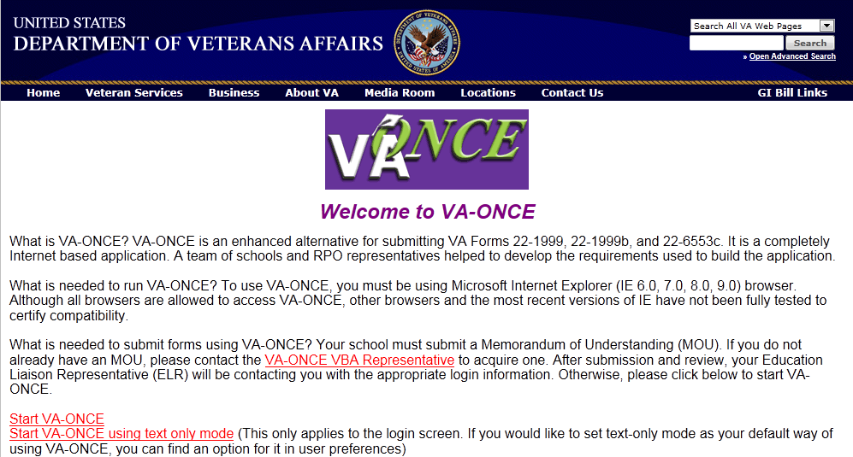
https://vaonce.vba.va.gov/vaonce_student/default.asp
For Best Results, use Internet Explorer
Some functionality will not work correctly with Chrome or Firefox

Slide 3
How do I obtain a VA Once Account
Request Access through the ELR -(Contact Info Presentation)
The ELR will require an updated 8794 – Designation of Certifying Officials form signed by someone authorized by your institution to add/remove SCOs.
Adding an SCO – Complete an 8794 with everyone that is currently designated, plus the new person.
Removing an ACO – Complete an 8794 with everyone that needs to retain VA Once Access, without including the individual who needs to be removed.

Slide 4
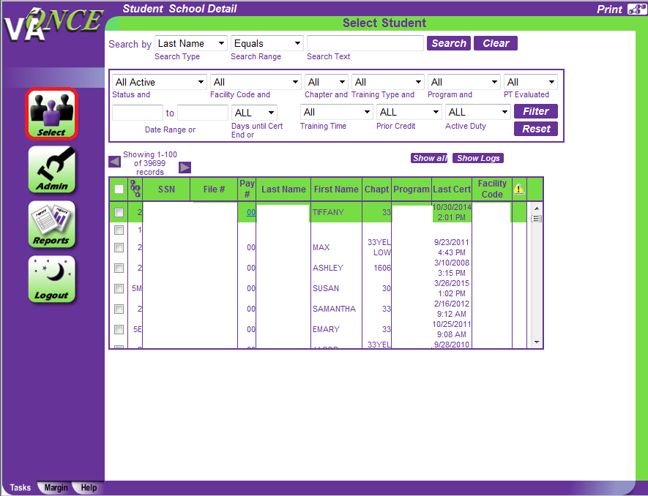

Slide 5
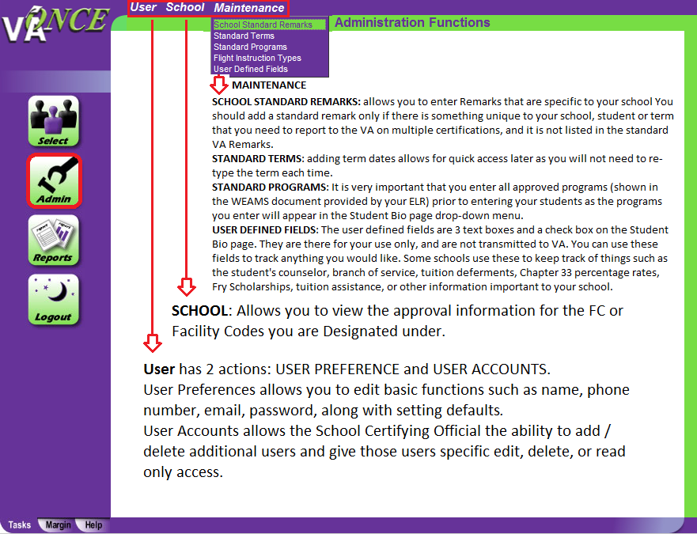

Slide 6
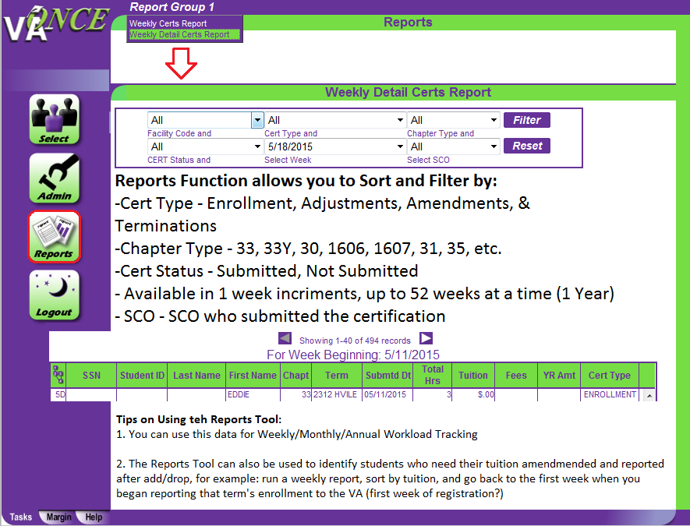

Slide 7
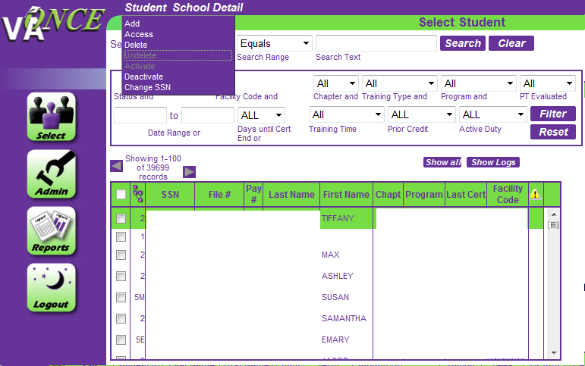

Slide 8
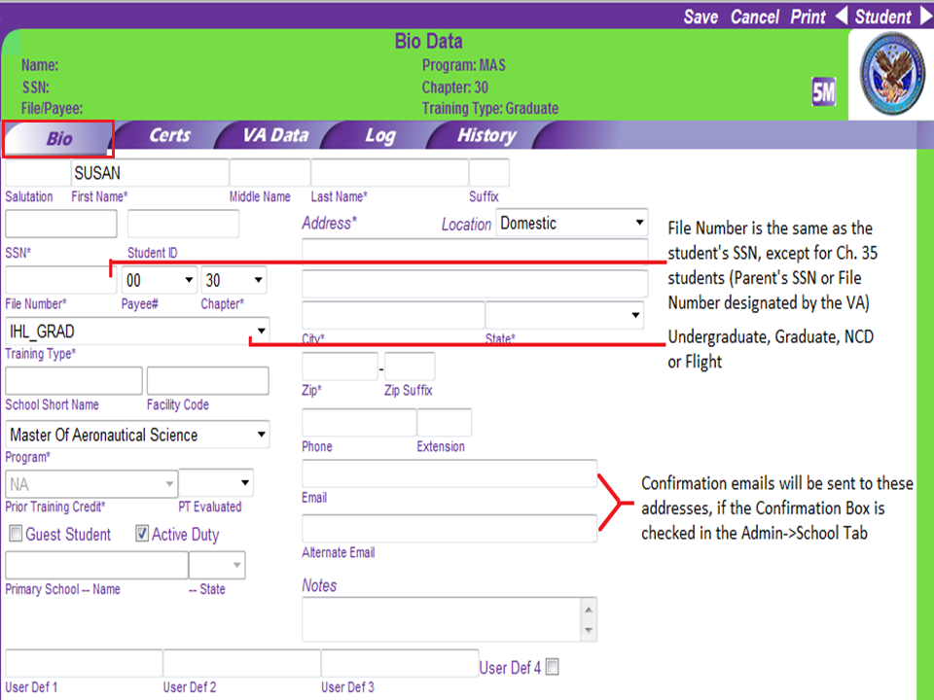

Slide 9
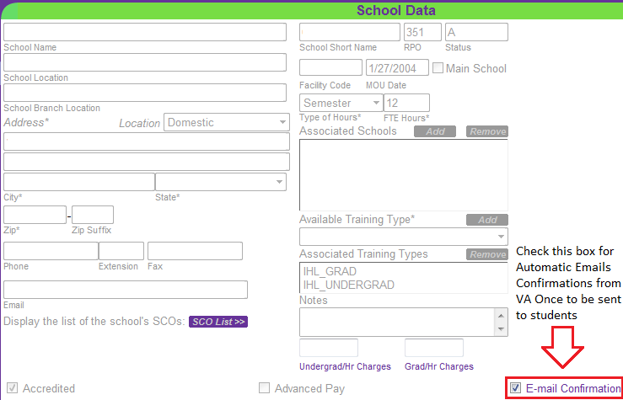

Slide 10
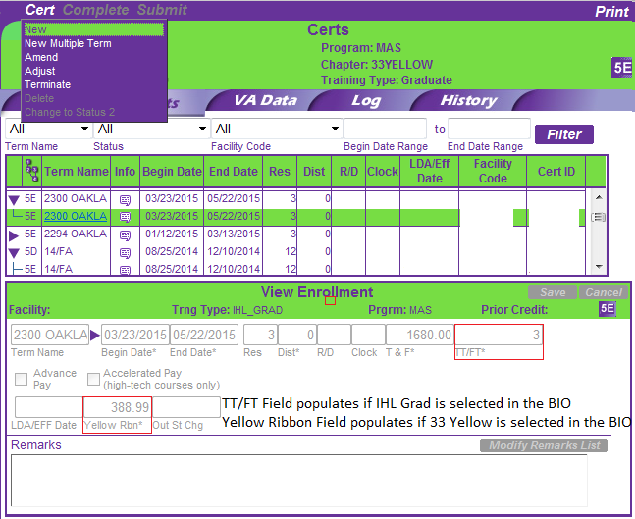

Slide 11
Modifying Enrollment Certifications
When to Adjust, Amend, or Terminate
Adjustment–used when reporting a decrease (not to zero) or increase in hours for the term, or to change the breakdown in modality:
  Withdraw Add/Drop
  Modality Change – Hours stay the same but the breakdown of Residence/Distance Hours Change
    Note: The Effective date for a modality change should be reported as the first day of the term
Amend –used to report changes to dates changes in tuition and fees.
Terminate–used to report Graduations and Suspensions, or when a student drops or withdraws from all classes:
  Drop or Withdraw from all classes
  Graduation
  Suspended or Dismissed

Slide 12
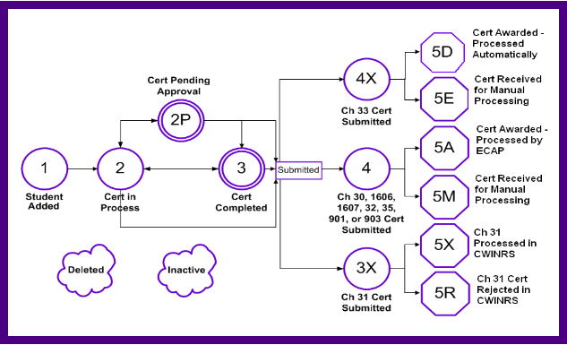
Processing Status Flow Chart

Slide 13
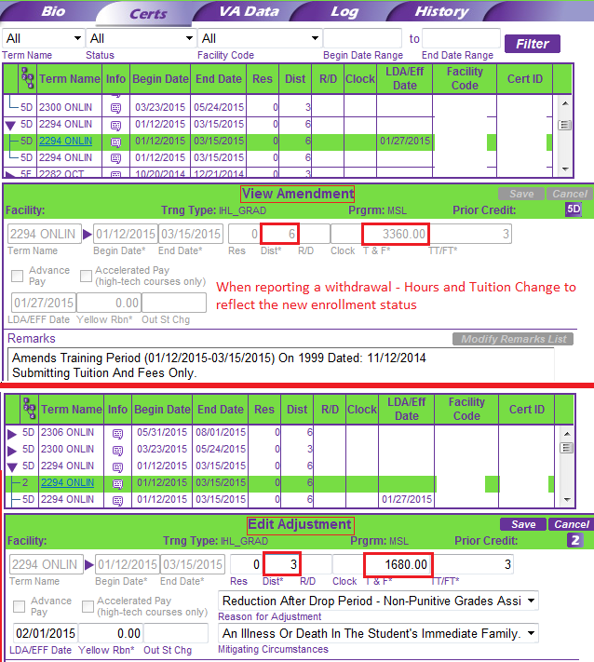

Slide 14
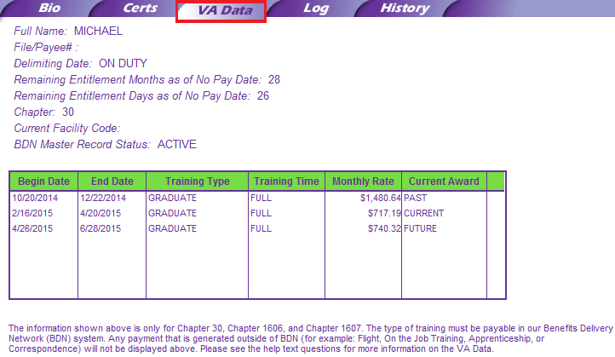

Slide 15
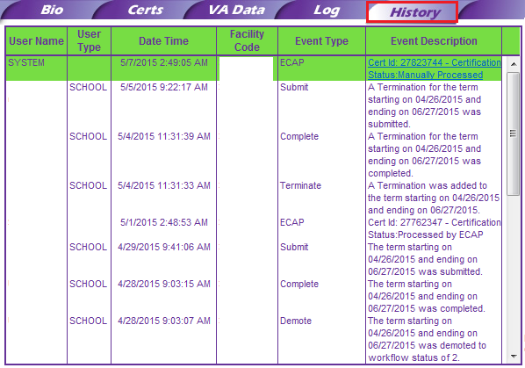

Slide 16
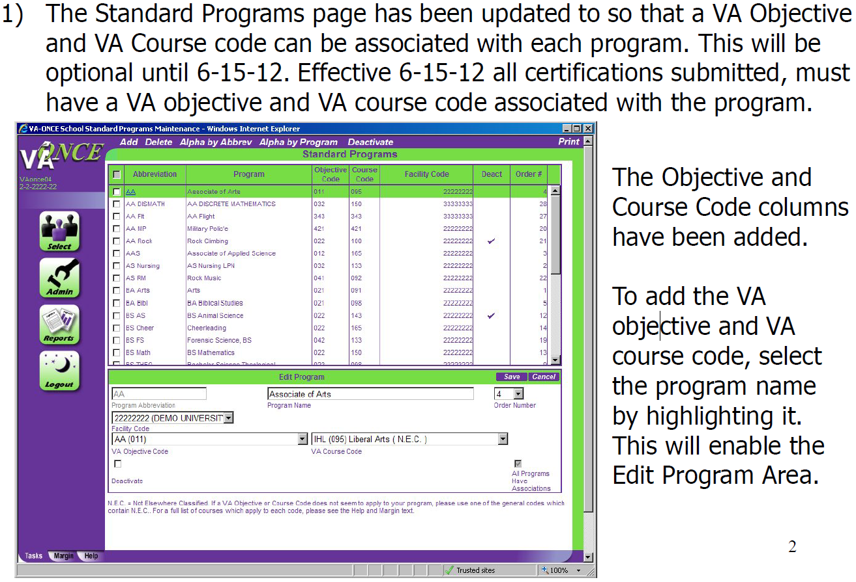

Slide 17
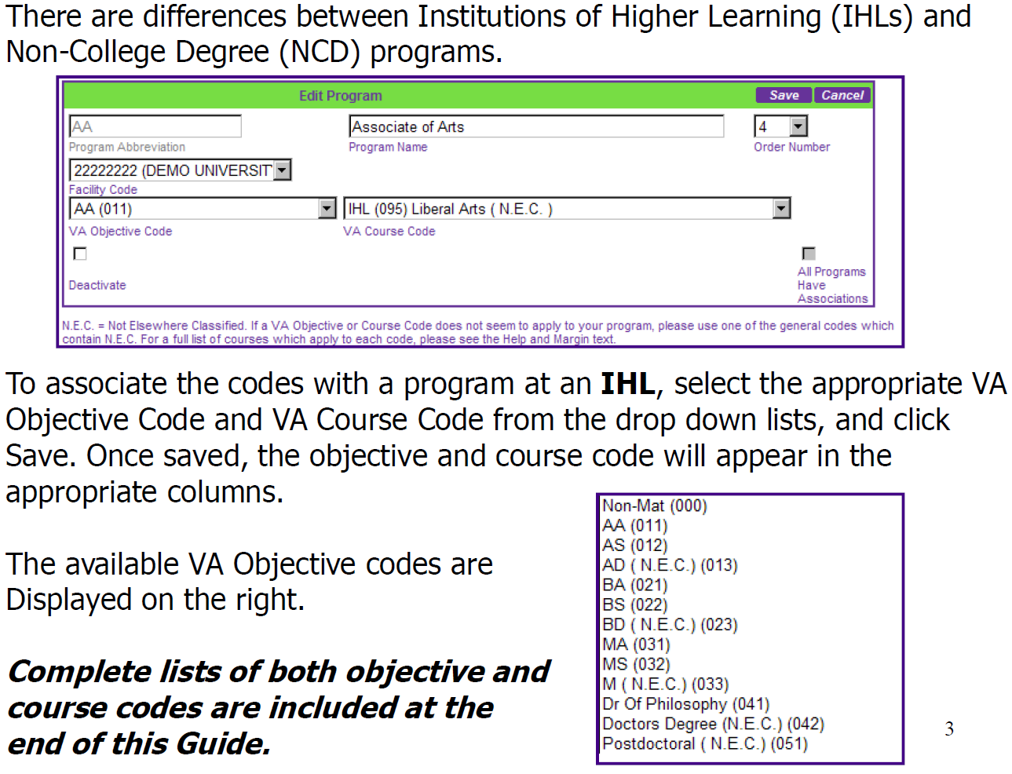

Slide 18
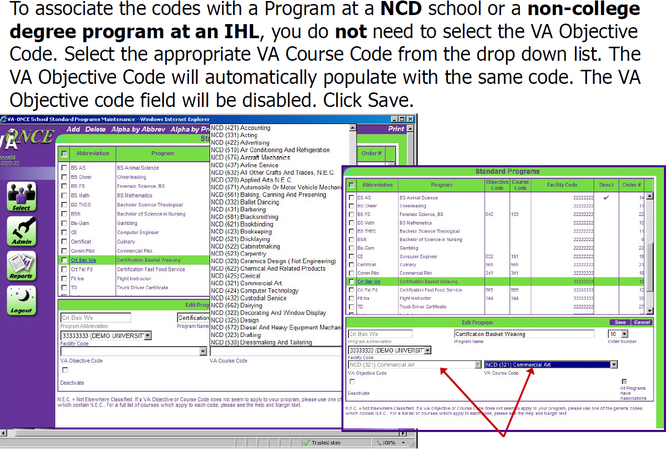

Slide 19
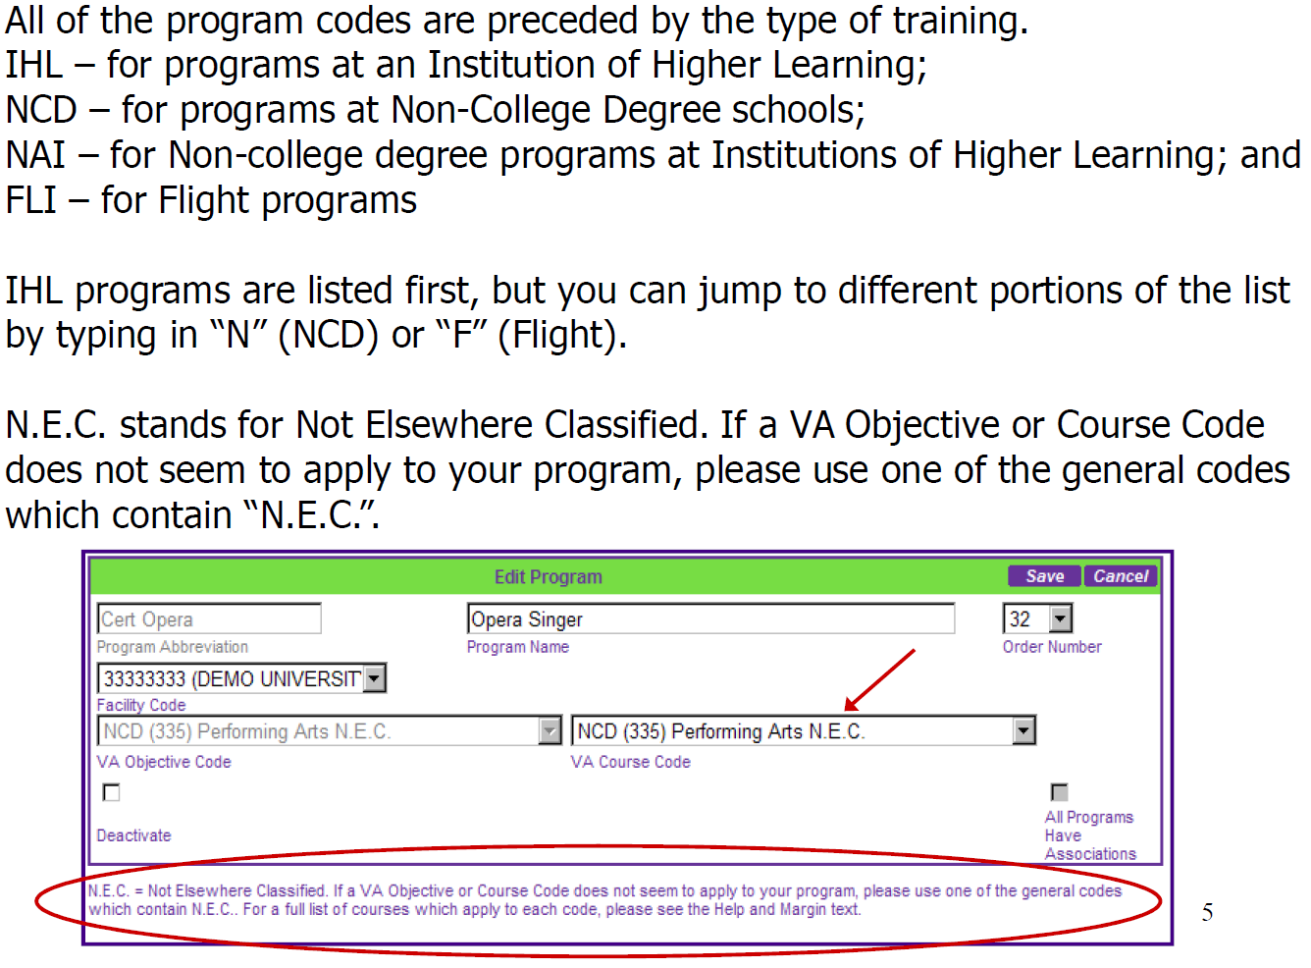

Slide 20
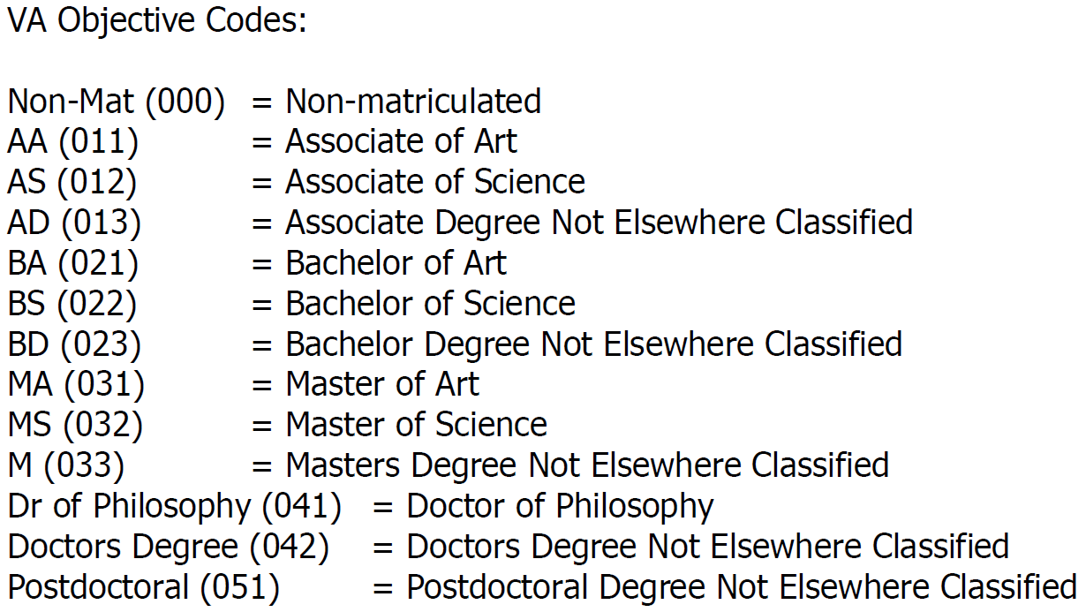

Slide 21
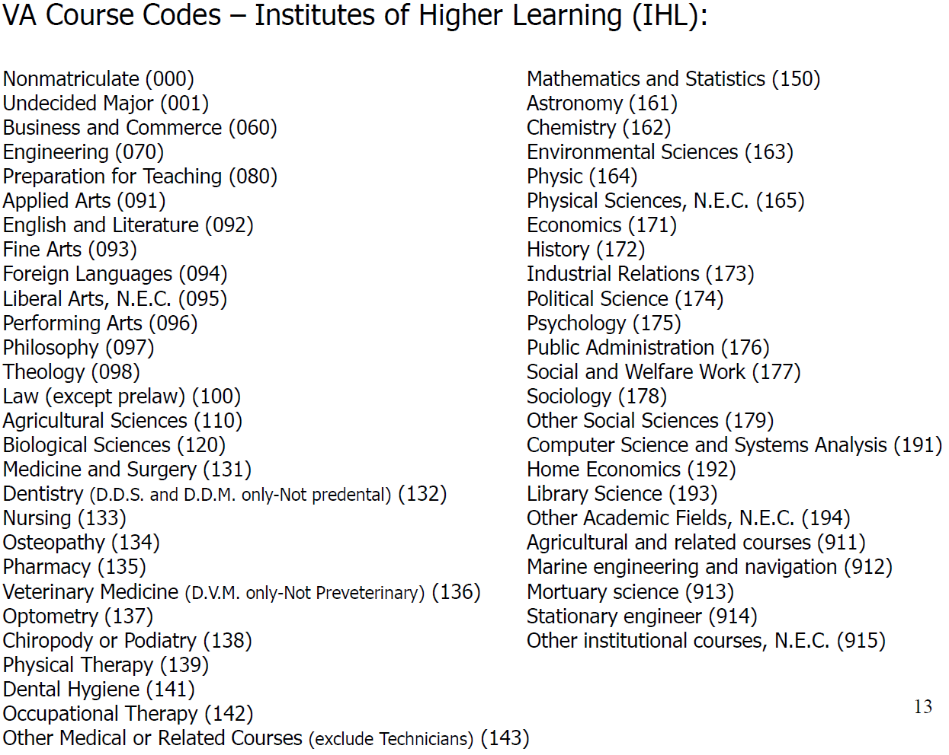

Slide 22
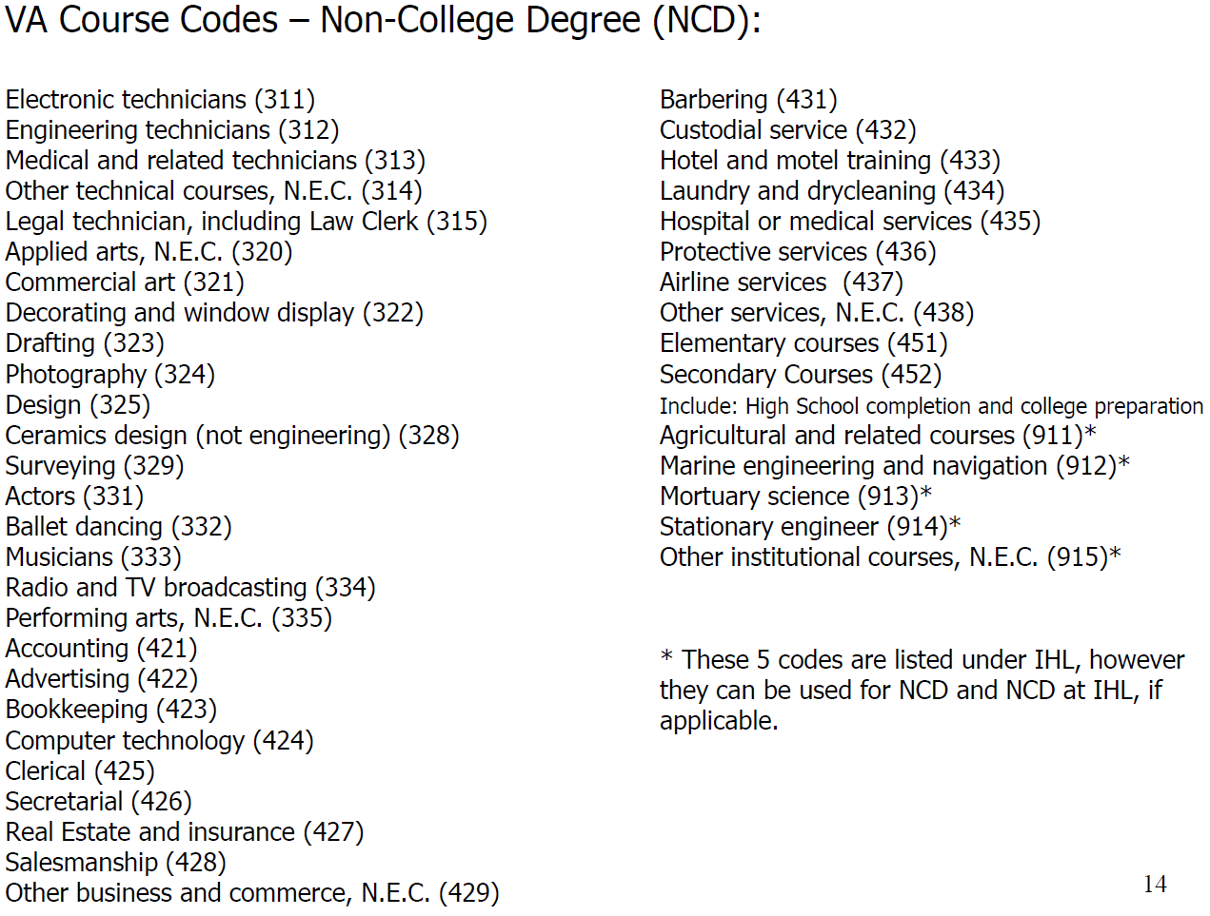

Slide 23
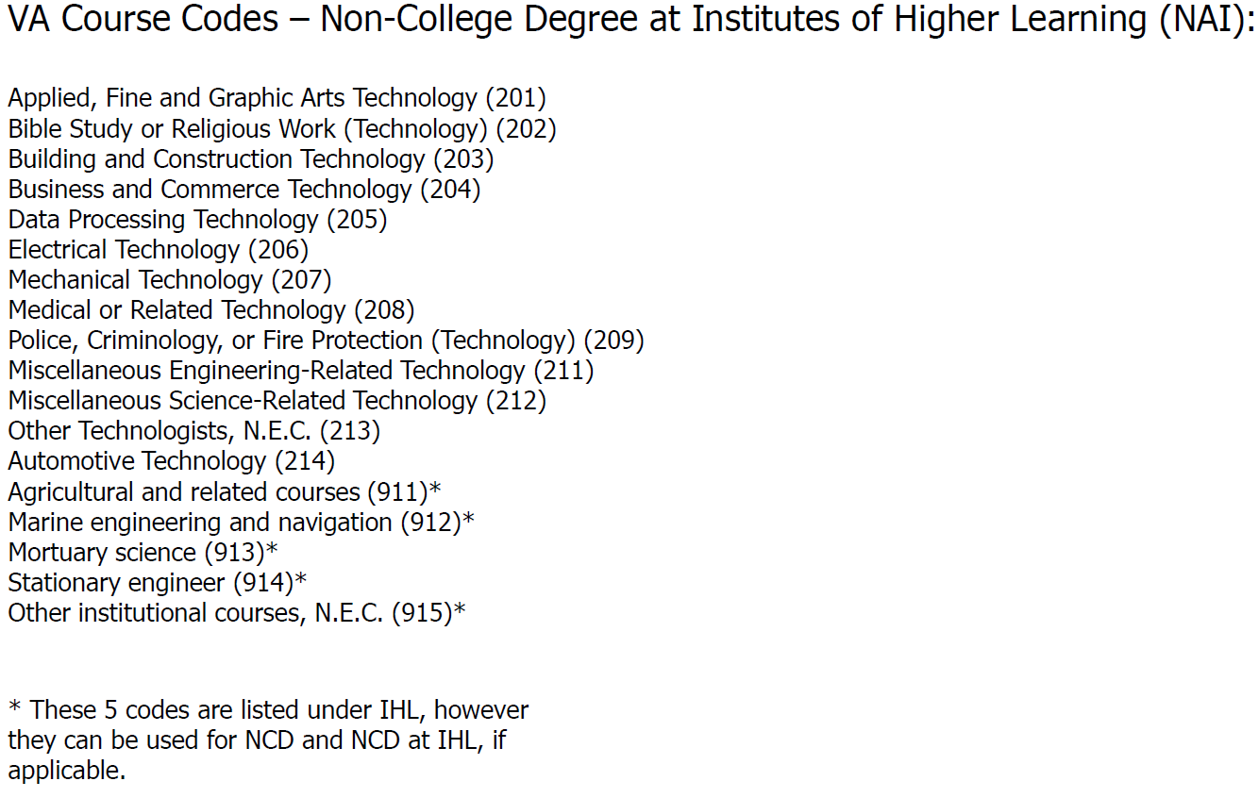

Slide 24
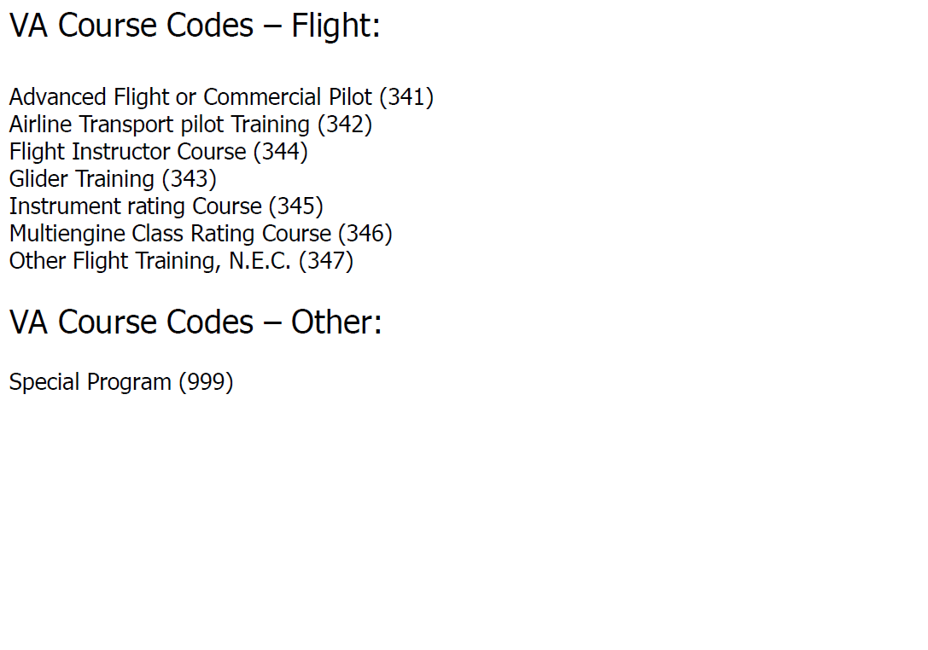

Slide 25
Questions?

