Slide 1


Slide 2
Pop Quiz
What does USO stand for?
United Service Organizations
When was it formed?
February 1941
Under which president?
Franklin D. Roosevelt

Slide 3
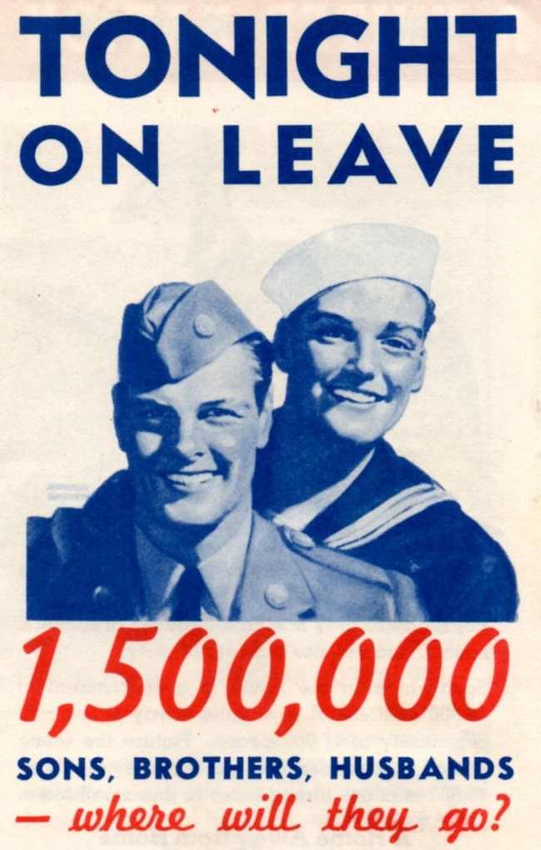

Slide 4



Slide 5
What do the 6 stars in the USO logo stand for?
  YMCA
  YWCA
  National Catholic Community Services
  National Jewish Welfare Board
  Travelers Aid Association
  Salvation Army

Slide 6
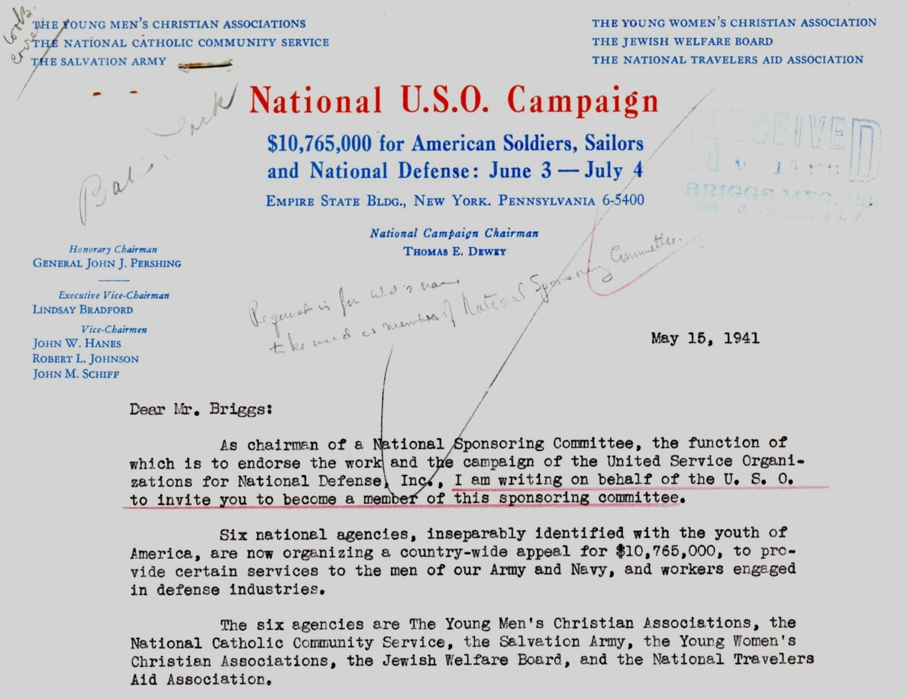

Slide 7
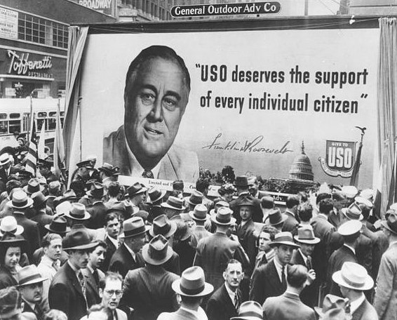

Slide 8
Our Mission:
Family. Home. Country.
The USO strengthens America’s military service members by keeping them connected to family, home and country, throughout their service to the nation.

Slide 9
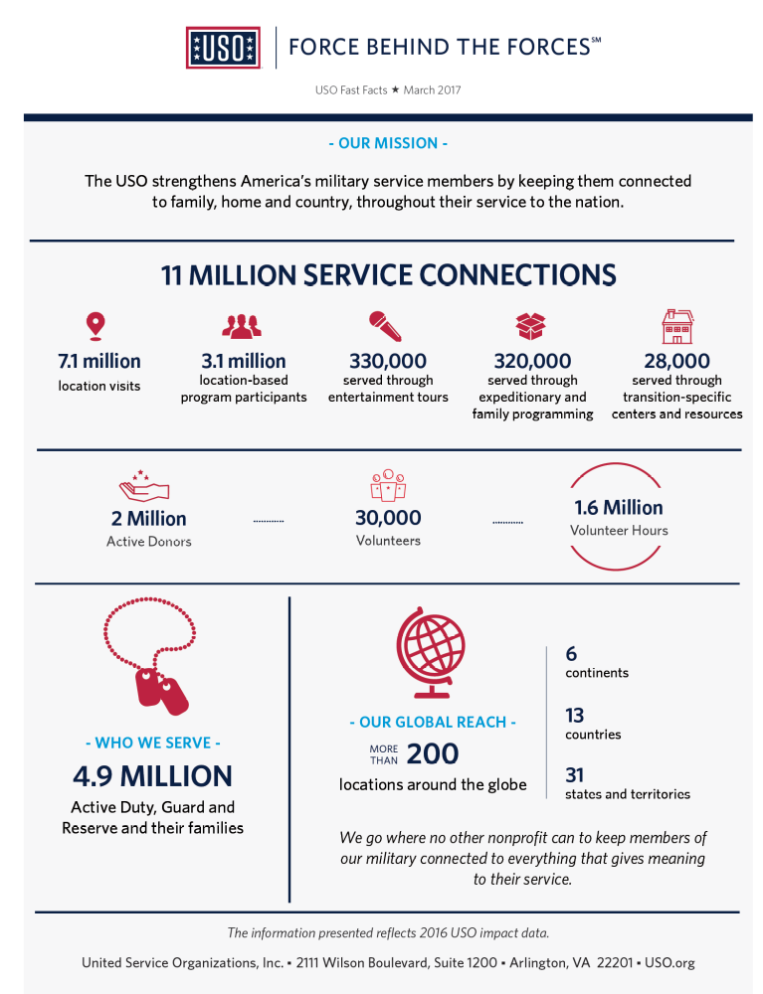
THE USO TODAY
200 Locations
7.1 Million Location Visits
3.1 Million Program Participants
2 Million Donors
30,000 Volunteers
1.6 Million Volunteer Hours

Slide 10
Originally established in 2012 – USO Tampa Bay
501 (c) 3 Non-Profit Organization
Current Locations:
Tampa International Airport
Tampa VA Hospital
Orlando International Airport
Staff: 3
Volunteers: 350

Slide 11
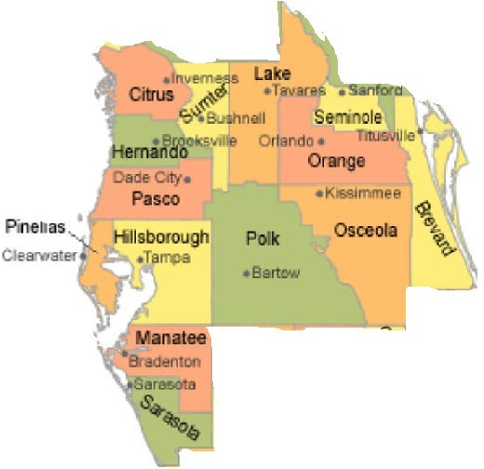
14-County Region
Hernando
Hillsborough
Pasco
Pinellas
Polk
Manatee
Sarasota
Citrus
Sumter
Lake
Orange
Seminole
Osceola
Brevard

Slide 12
PROGRAMS – SERVICE MEMBERS
USO Care Package Program
Mobile USO (United States)
Holiday Care Packages
Mobile Entertainment Gaming Systems (Remote locations)
USO2GO (Remote locations)
Operation Phone Home
United Through Reading
Entertainment Tours

Slide 13
SERVICE MEMBERS & FAMILIES
Stronger Families: Couples Seminar
Operation That’s My Dress
USO & What to Expect: Special Delivery (Baby Showers)
Sesame Street/ USO Experience for Military Families
Comfort Crew for Military Kids

Slide 14
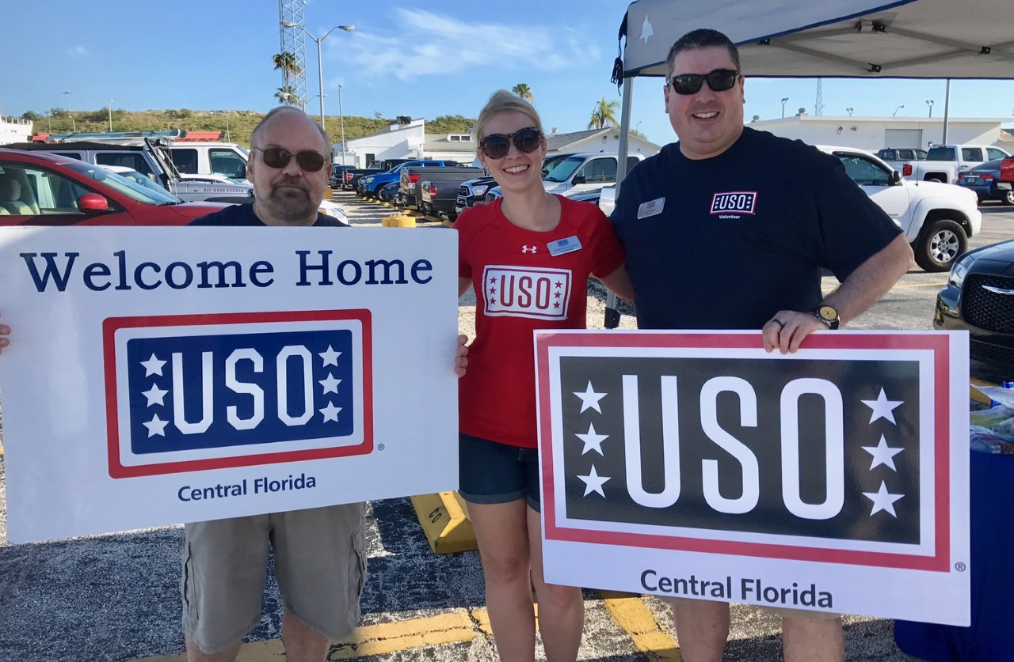
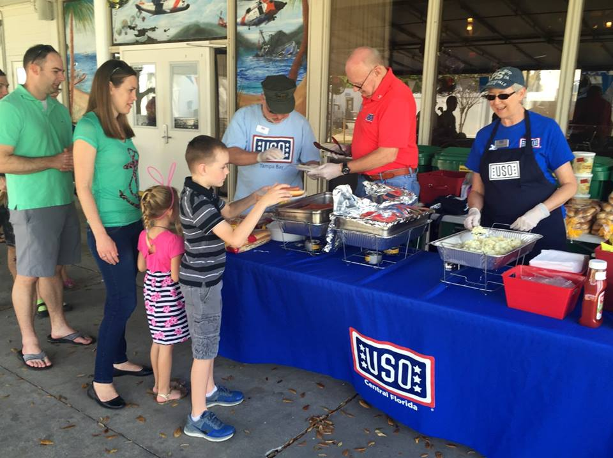
PROGRAMS – SERVICe MEMBERS & FAMILIES

Slide 15
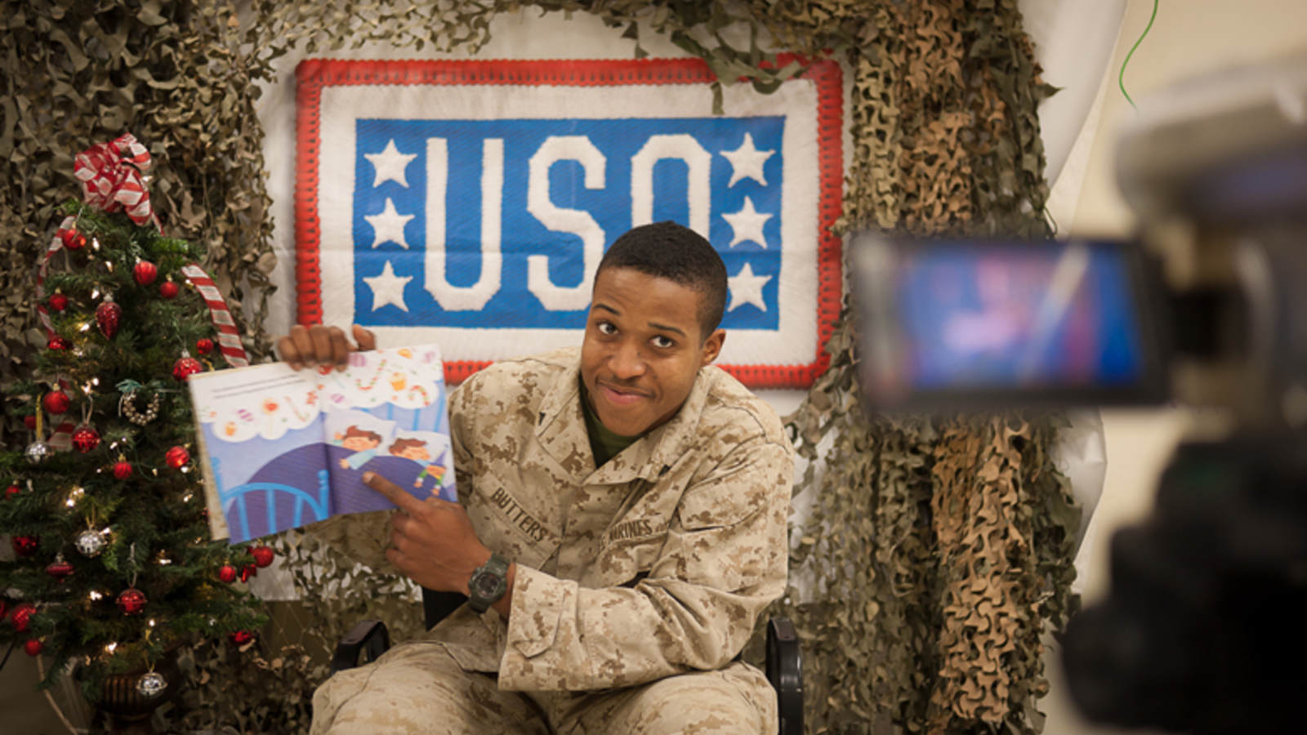
UNITED THROUGH READING
United Through Reading helps ease the stress of separation for military families by having service members who are separated from the children they love read children’s books aloud on video for the child to watch at home.
USO Centers & Locations
Additional locations available at: www.unitedthroughreading.org

Slide 16
USO Central florida programs
Tampa Bay/Gulf Coast
TIA Welcome Center
Day Room @ James Haley VA Hospital
Welcome Home Greetings
Deployment Send Offs
Morale Events & Family Events
No Dough Dinners
USO Welcome Wagon
Back to School Drive
Stuff a Stocking
Orlando/Space Coast
OIA Welcome Center
Welcome Home Greetings
Deployment Send Offs
Morale & Family Events
Back to School Drive
Stuff a Stocking

Slide 17
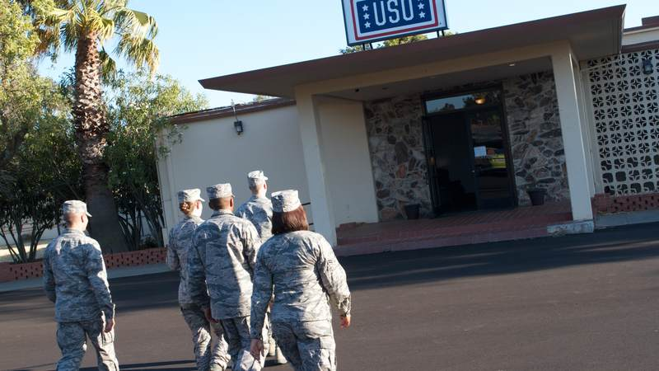
USO CENTERS
More than 200 USO locations worldwide, including Afghanistan, Djibouti, Kuwait, United Arab Emirates, Germany, Italy, Japan, Iraq, South Korea and the United States.
In 2016, over 7 million visits by service members and their families.
USO centers provide a warm and comforting place where service members can connect to loved ones via Internet or phone, play a video game, catch a movie, have a snack or just put their feet up and relax.

Slide 18
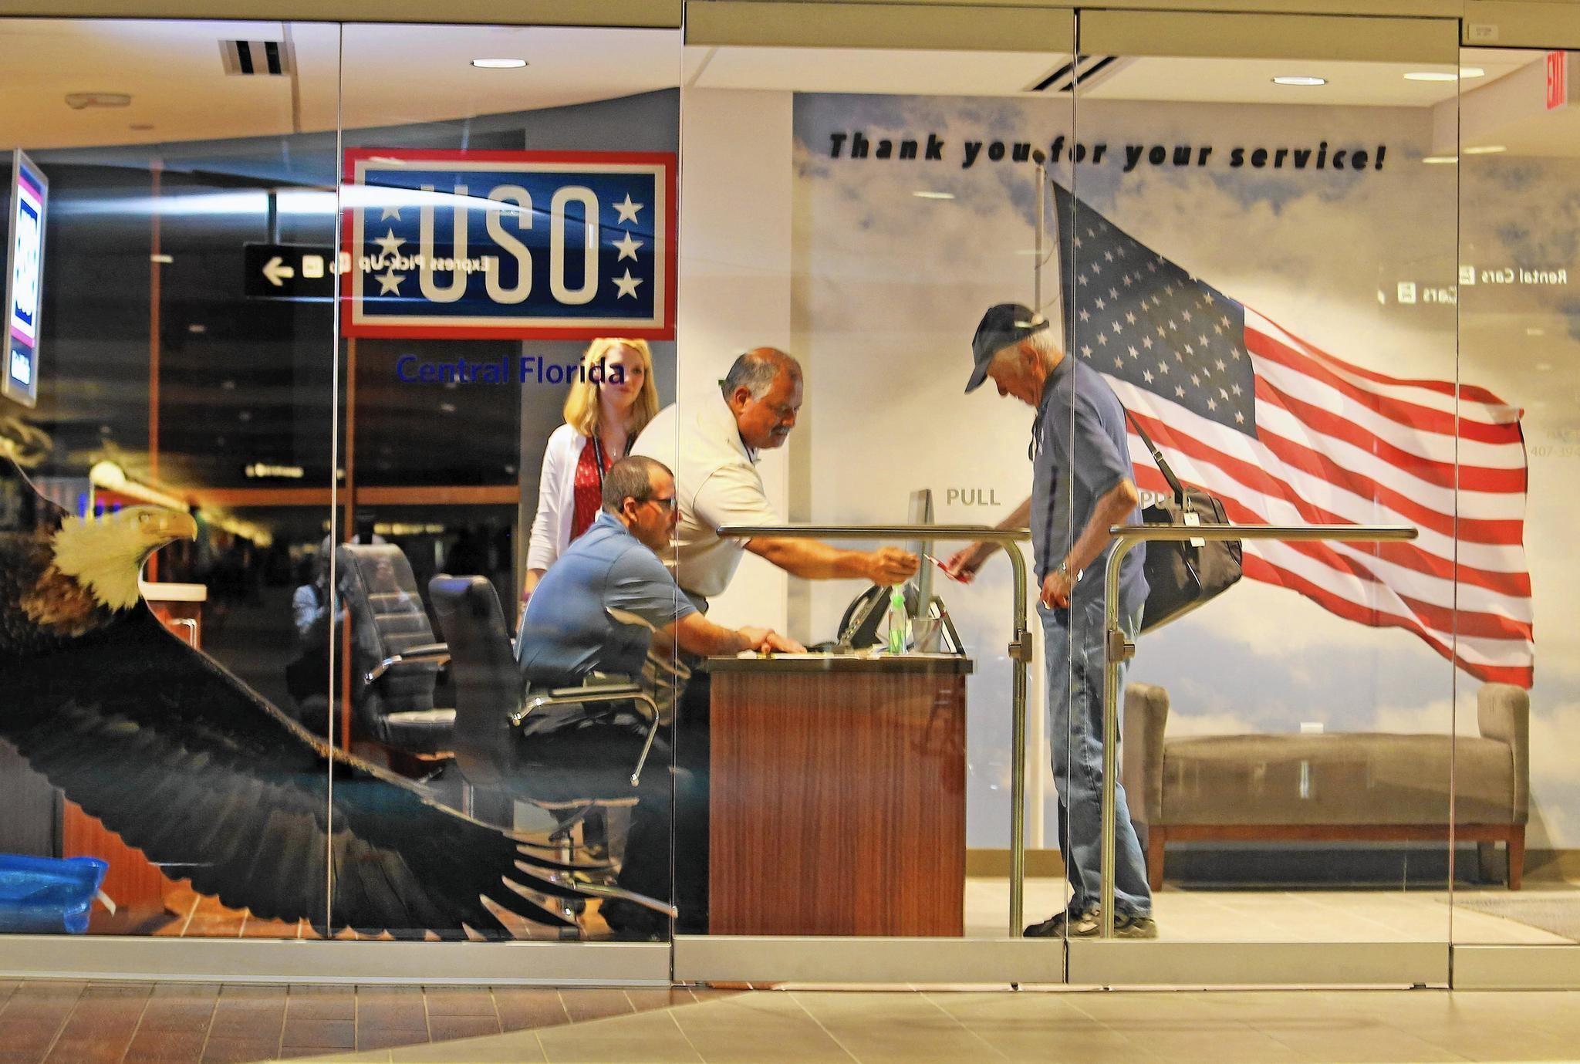
ORLANDO CENTER
A “home away from home” for active duty service members and their families. Retirees and Veterans are also welcomed on space available basis.
Amenities such as free snacks and beverages, computers, TVs, recliners and a children’s play area.
Open 6:00 am – 8:00 pm everyday; 365 days a year!
Operated by volunteers

Slide 19
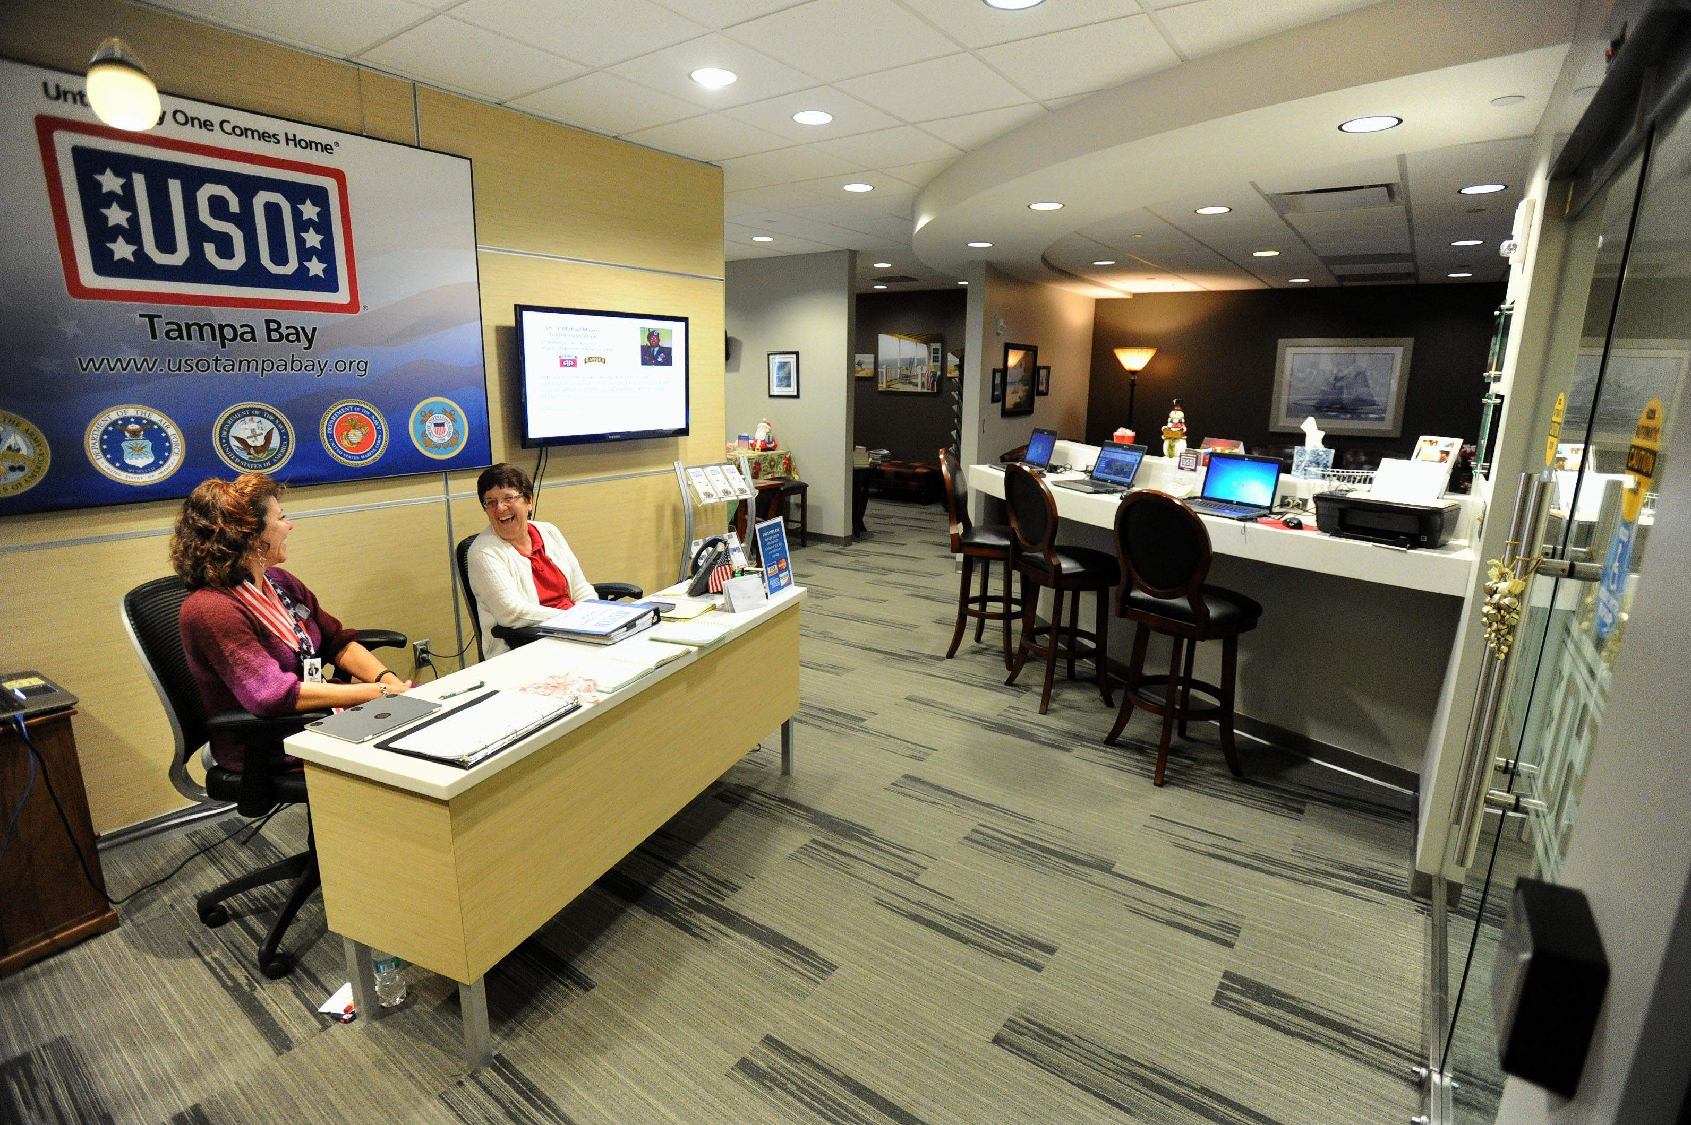
TAMPA CENTER
A “home away from home” for active duty service members and their families. Retirees and Veterans are also welcomed on space available basis.
Amenities such as free snacks and beverages, computers, TV, and couches.
Open 8:00 am – 8:00 pm everyday; 365 days a year!
Operated by volunteers

Slide 20



Stay Connected!
Website: www.usocentralflorida.org
Volunteers: http://volunteers.uso.org
Follow USO Central Florida on Social Media
FACEBOOK
USO Central Florida
USO Central Florida - Tampa
TWITTER
@USO_CentralFL
INSTRAGRAM
usocentralfl

